Slide 1

Promising pathways to food safety!
Group: ShineLightFlame666

Slide 2
Problem Statement
WHAT:
Key Problems in Food Security
WHY:
Our mission
(Objective)
Severer impact
How to control the situation of food unsafety?
HOW-1:
Our Solution
Complicated interactions
How to track the insecure details and pinpoint where the issues were in synthesized factors and organizations?…
HOW-2:
Architecture
Tendencies
Control
How to predict automatically based on historical records or data to prevent? …
Notes:
The severer impact of food unsafety in past decade: How to control the situation of food-unsafety?
2. Complicated interactions of factors from micro to macro levels: How to track the insecure details and pinpoint where the issues were in synthesized factors and organizations, etc.
3. The tendencies towards a potential food-unsafety could not be controlled well: How to predict automatically based on historical records or data to prevent? etc.

Slide 3
Approach to SOLVE!
WHAT:
Key Problems in Food Security
Research
Factors:
that affect food security
WHY:
Our mission
(Objective)
Data analytics:
Determine the factor will affect
Implement framework:
Practical, interactive, predictive framework
HOW-1:
Our Solution
HOW-2:
Architecture
Notes:
Objective:
The project contributes to the implementation of a practical, interactive and predictive
Ecosystem framework that could be assistant on the pathways to improve food security, based on deep research on the factors of food that may affect the food processing & consuming. Also, with the help of data analytics the project can determine factors affecting the overall health of the human population.

Slide 4


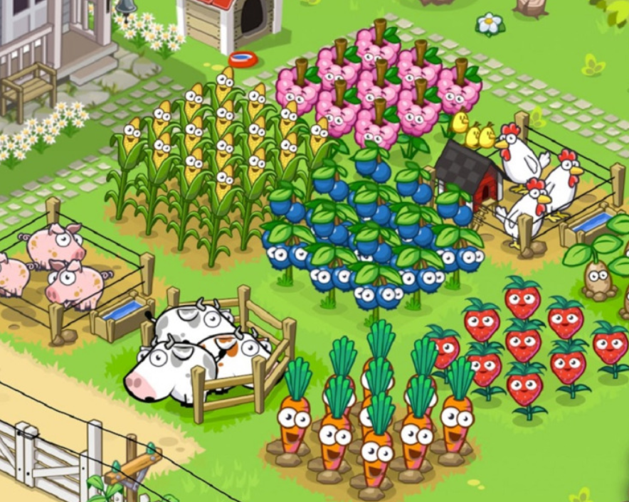



WHY:
Our mission
(Objective)
Analytics & Suggestion
WHAT:
Key Problems in Food Security
Analytics & Suggestion
Issue Submission
Farm/Raw Material
Produced/Packaged Food
Served Food
HOW-1:
Our Solution
HOW-2:
Architecture
Food Produce
Food Process
Food Serving
Track
Track

Slide 5
Object Model

Slide 6
Ecosystem
WHY:
Our mission
(Objective)
Network
Enterprise
Food Producer
Food Processor
WHAT:
Key Problems in Food Security
Super Market
Restaurant
Organization
Admin
Sales
Sterilization
HOW-1:
Our Solution
Manage
Purchase
Staff Directory
Staff
Order/Feedback Queue
HOW-2:
Architecture
Roles
Producer
Process
Server

Slide 7
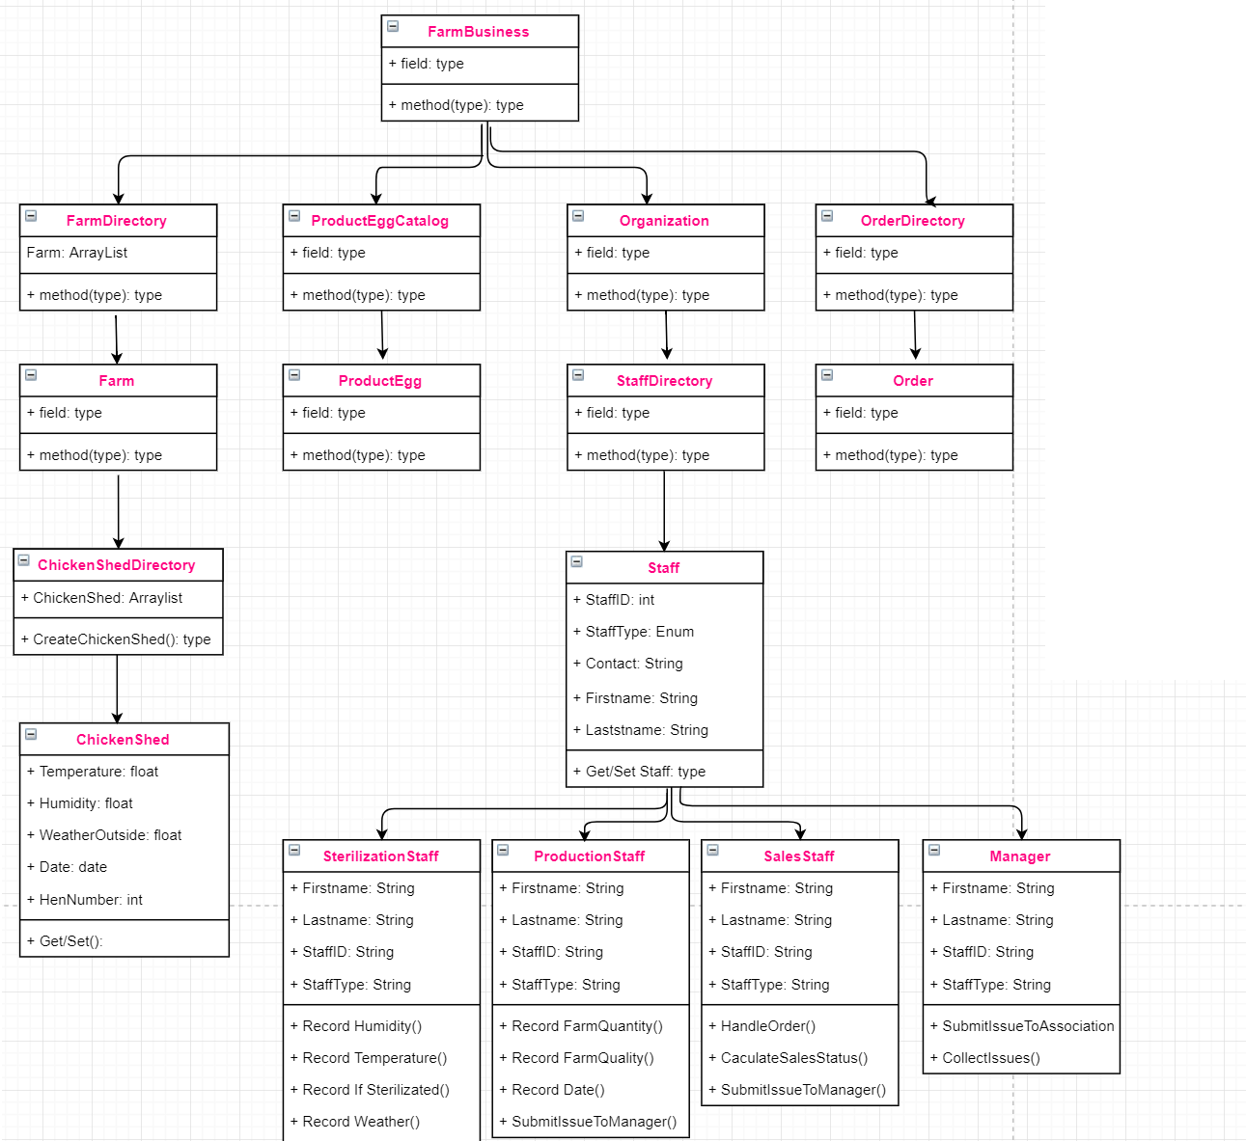
Produce
Process
Serve
Alert
Analysis
Alert
Predict

Slide 8
User Cases

Slide 9
Produce
Process
Serve
Alert
Analysis
Alert
Predict
WHY:
Our mission
(Objective)
Farm/Raw Material
Record:
(1) Product Info(E.g.: Egg): Producing Date
(2) Plant Info(E.g.: Roost): Temperature, Humidity, sterilization time
(3) Climate Info: Weather, Season.
2. Processing Order:
(1) Receive the Order from processors.
WHAT:
Key Problems in Food Security
HOW-1:
Our Solution
Food Producer
HOW-2:
Architecture

Slide 10
Produce
Process
Serve
Alert
Analysis
Alert
Predict
WHY:
Our mission
(Objective)
Produced/Packaged Food
Record:
(1) Provider of Food Producing: Name, Region, Owner…
(2) Raw Material Info.: Provider, Quantity, Purchasing Date, Repository…
(3) Semi-Finished Product Info: Producing Date, Line Number, Work plant Number…
2. Process Order：
(1) Handle the orders from Server;
(2) Order from Producer;
WHAT:
Key Problems in Food Security
HOW-1:
Our Solution
Food Process
HOW-2:
Architecture

Slide 11
Produce
Process
Serve
Alert
Analysis
Alert
Predict
WHY:
Our mission
(Objective)
Record:
Product Info: Provider, Transportation Company, Delivery Date, Repository No., …
City Info: City, Climate, Weather …
2. Order from Producer:
Submit the order to producer: quantity, products info…
Served Food
WHAT:
Key Problems in Food Security
HOW-1:
Our Solution
Record:
Product Info: Provider, Transportation Company, Delivery Date…
Restaurant Info: Location, City, Zip code…
City Info: City, Climate, Weather …
2. Order from Producer:
Submit the order to producer: quantity, products info…
Food Serving
HOW-2:
Architecture

Slide 12



Produce
Process
Serve
Alert
Analysis
Alert
Predict
WHY:
Our mission
(Objective)
Feedback & Trackback!!!
Listen to your customer
Connect to your processor & Producer
WHAT:
Key Problems in Food Security
HOW-1:
Our Solution
FEEDBACK!
HOW-2:
Architecture

Slide 13
Produce
Process
Serve
Alert
Analysis
Alert
Predict
WHY:
Our mission
(Objective)
Collect:
Collect negative feedback submitted by customers, and abstract the word of symptoms from database.
2. Analysis:
Aggregate the symptoms and the cities which may have trend of disease.
3. Suggest:
If some issues occurs occasionally, suggest the tips to owners.
(E.g.: The issue of cake in restaurant: the eggs may probably save for undeserved and metamorphism when they are stored in repository with a higher temperature. Avoid it! Suggest temperature: under 70F.)
WHAT:
Key Problems in Food Security
HOW-1:
Our Solution
HOW-2:
Architecture

Slide 14
Produce
Process
Serve
Alert
Analysis
Alert
Predict
WHY:
Our mission
(Objective)
4. Announce:
If some issues occurs seriously in some nation, announce:
(1) Policy of domestic output: The product output is not allowed from this nation.
(2) Policy of foreign import: Other import from this nation is not allowed.
WHAT:
Key Problems in Food Security
HOW-1:
Our Solution
HOW-2:
Architecture

Slide 15
Highlighted Snapshot
Our Innovative Points
&
Alerts to the end users.

Slide 16
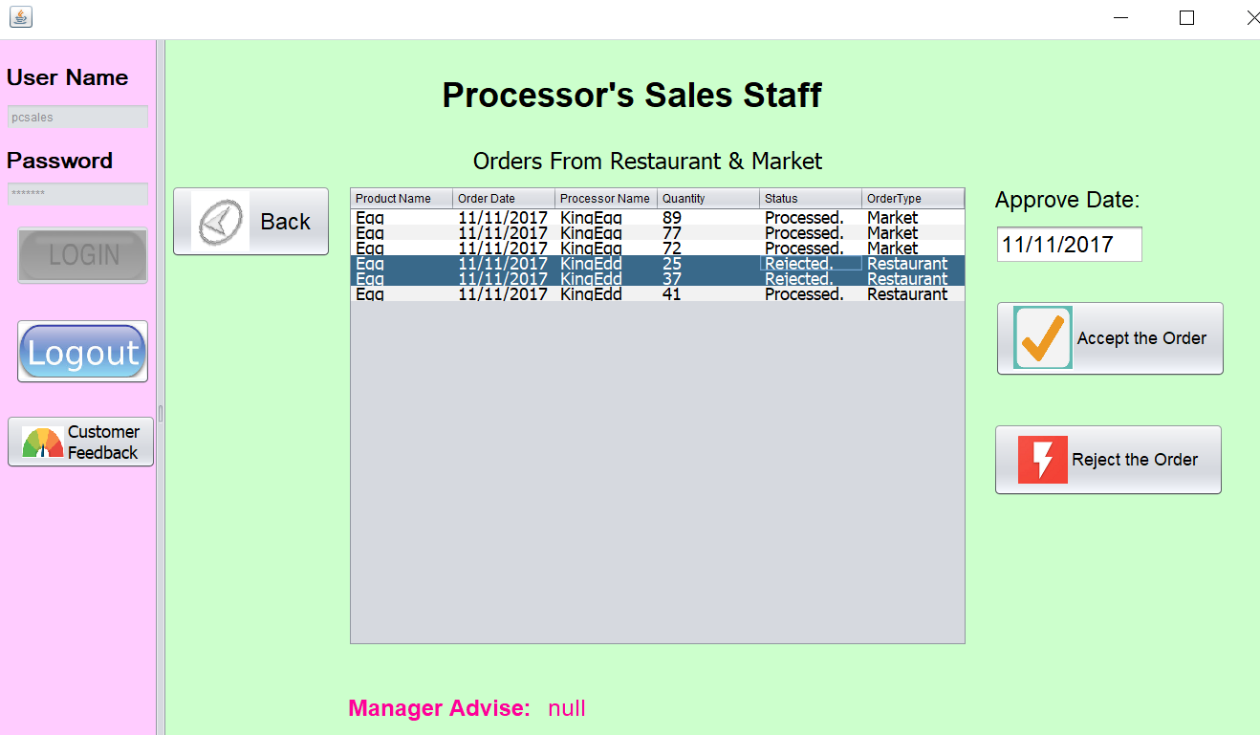
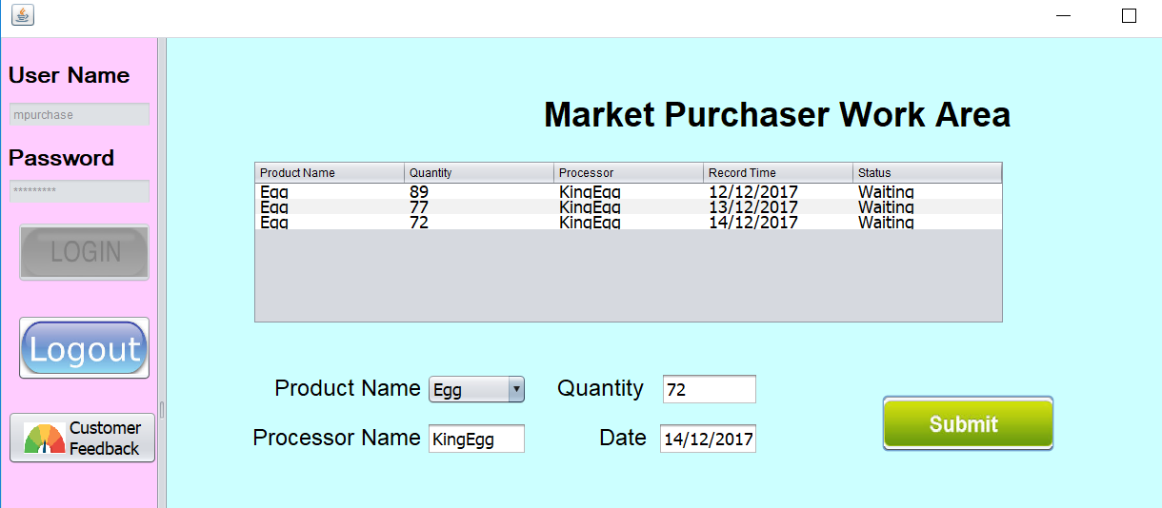
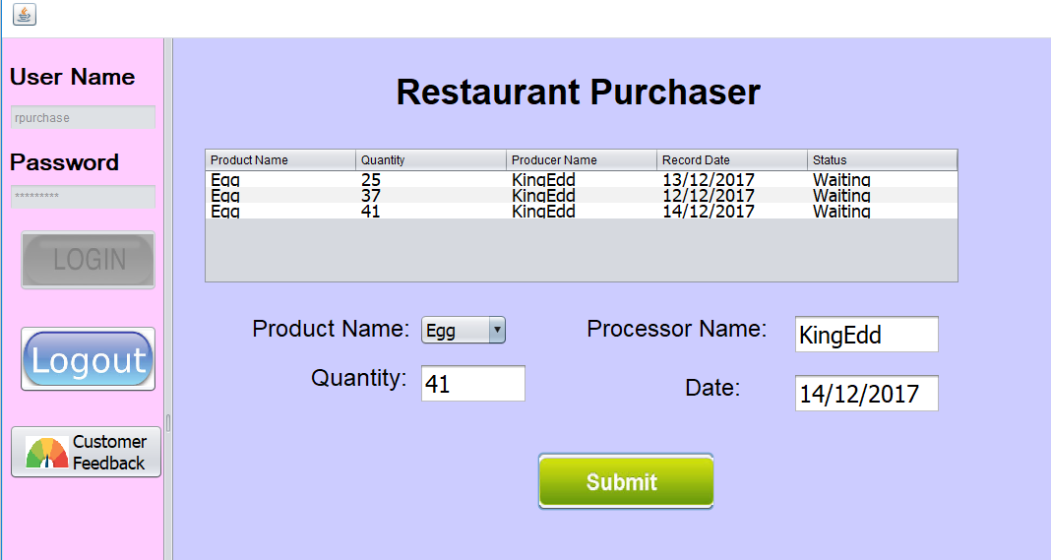
Market Purchaser: Make an order to Processor:
Processor: Process ALL the orders from Food Servers!
Restaurant Purchaser: Make an order to Processor:

Slide 17

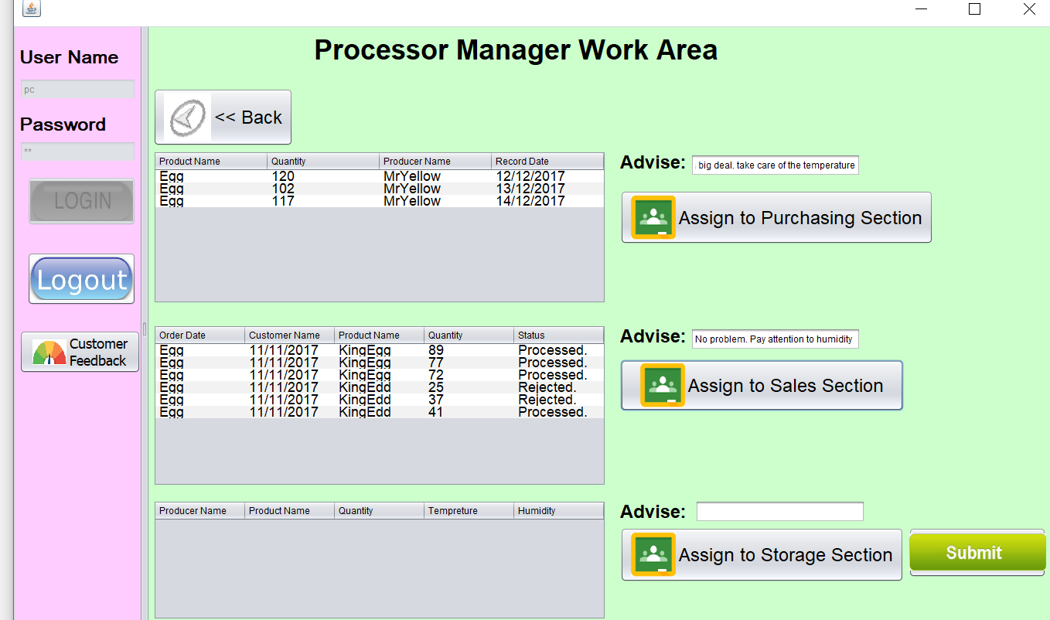

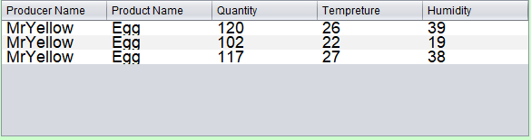
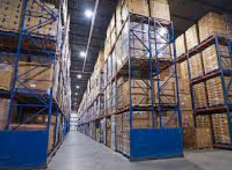

Multiple Message Processing on Processor Manager!
Processor Purchaser
Processor Sales
Distribute feedbacks to handle
Processor Storage

Slide 18
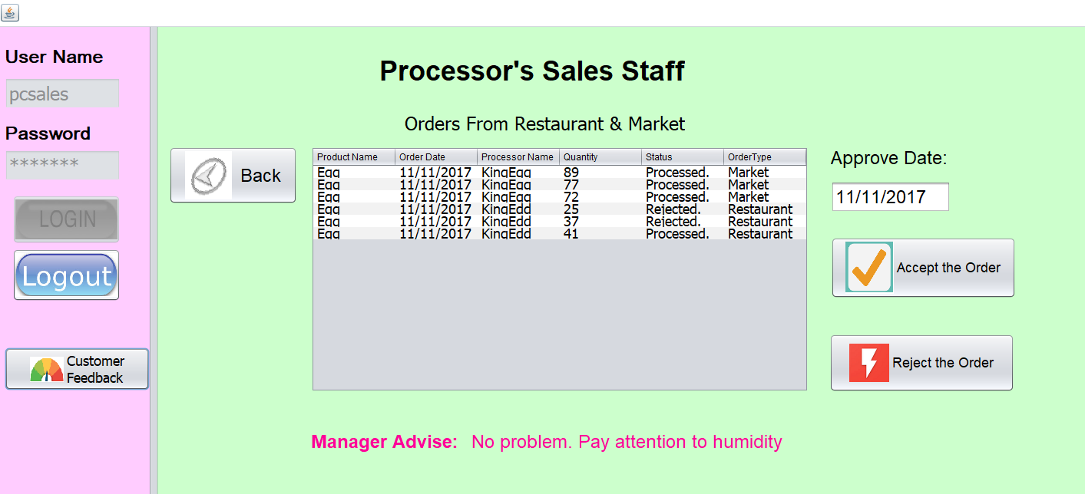
Processor Sales Received the comments from his manager!

Slide 19


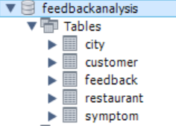

Analytics of Negative Feedback + Database

Slide 20
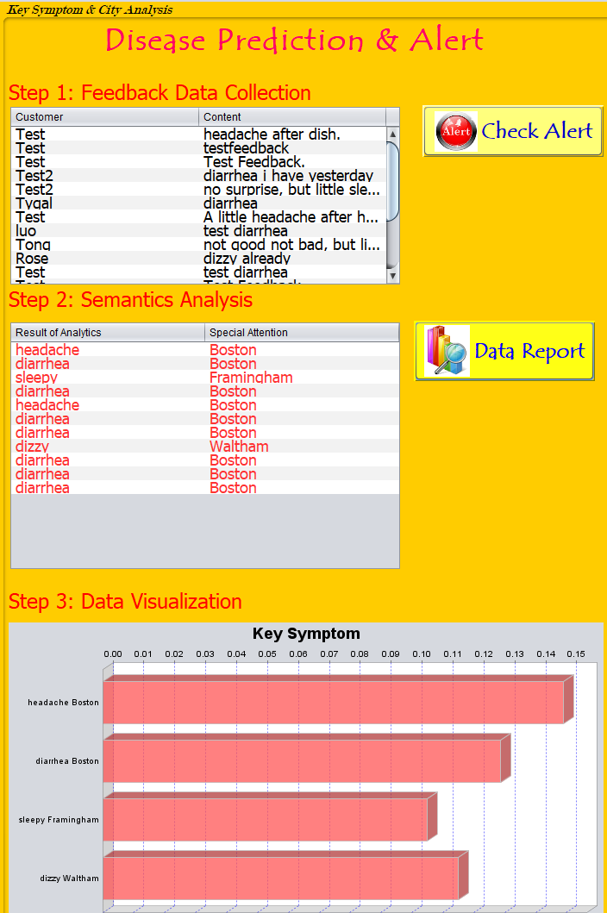
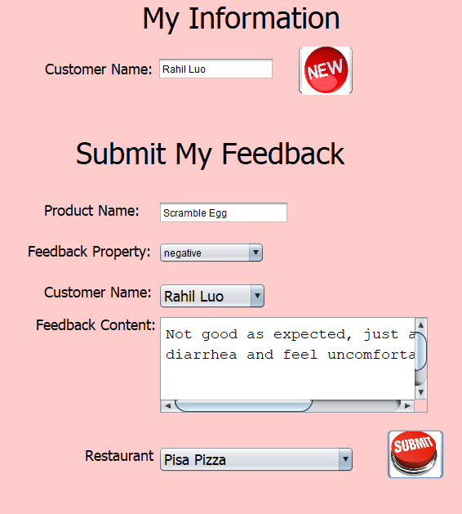
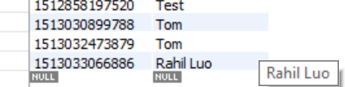
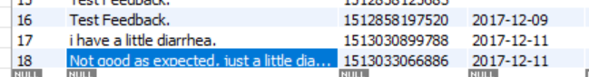
1. Semantics Analysis for Prediction & Control Disease
CUSTOMER：
FEEDBACK：
Headache Boston!
Alert: Potential City!!!

Slide 21
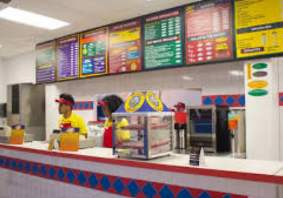

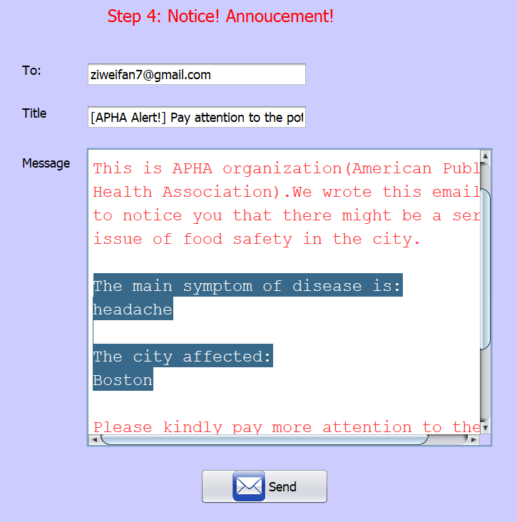
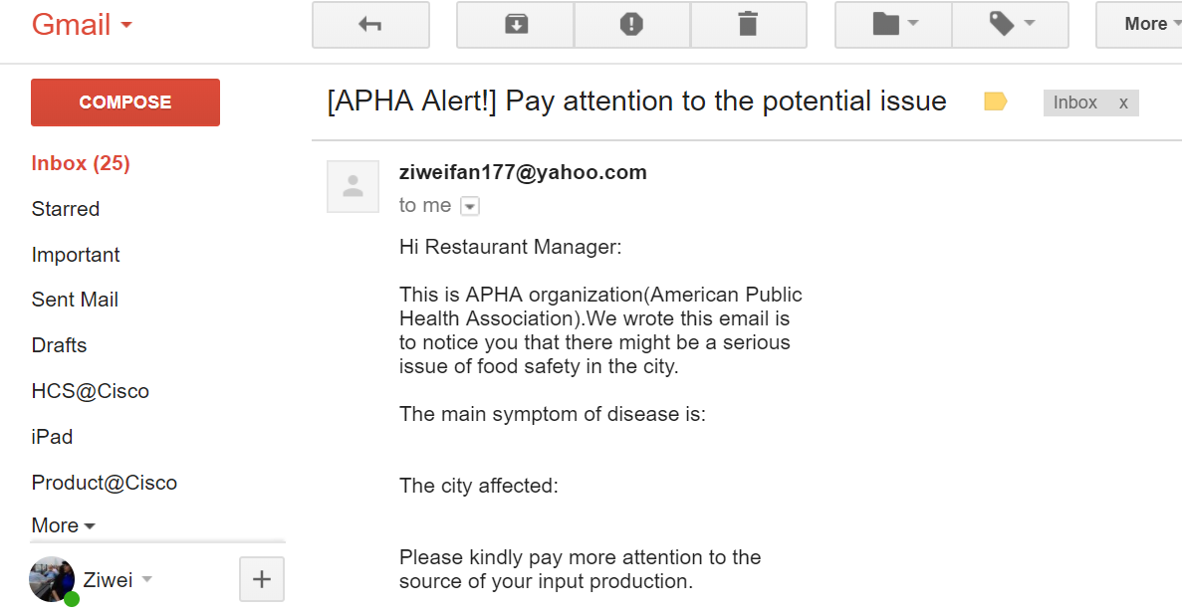
2. Announce the potential Issue of Food Safety!
Restaurant
SuperMarket
Alert: Potential City!!!

Slide 22
Other Snapshots
Networking, Enterprise, Organization
Employee & User Accounts
Orders & Feedbacks between different organizations

Slide 23
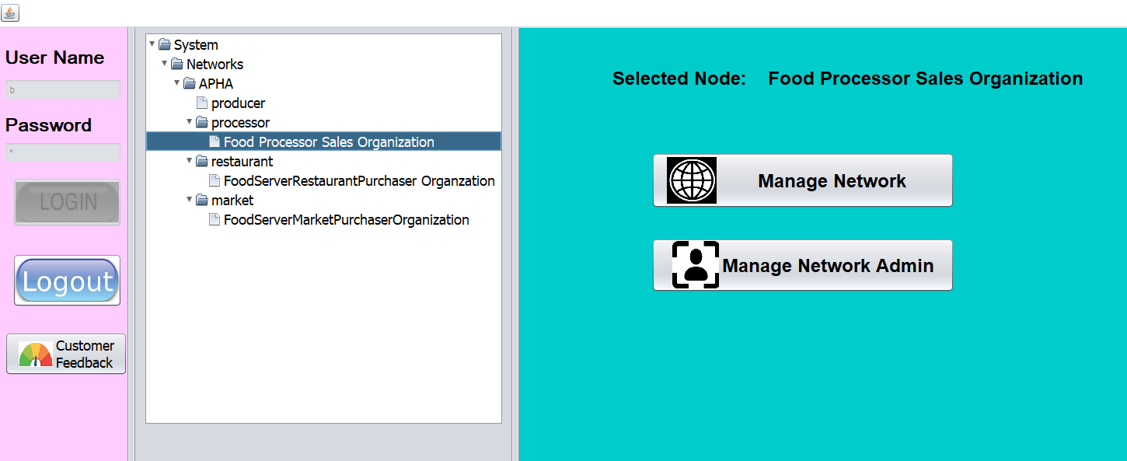
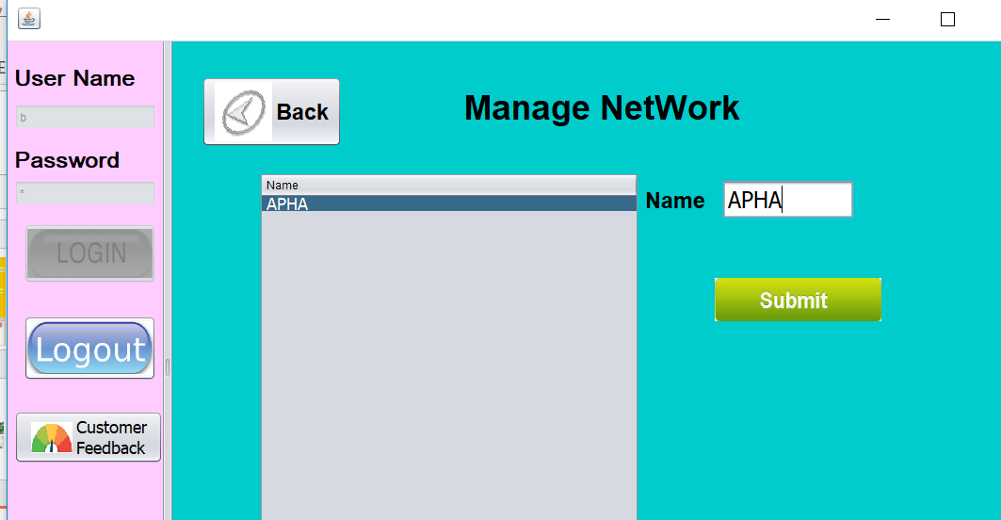
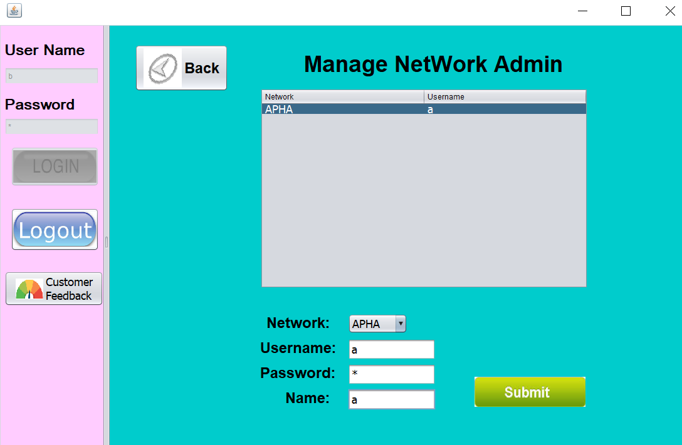

Slide 24
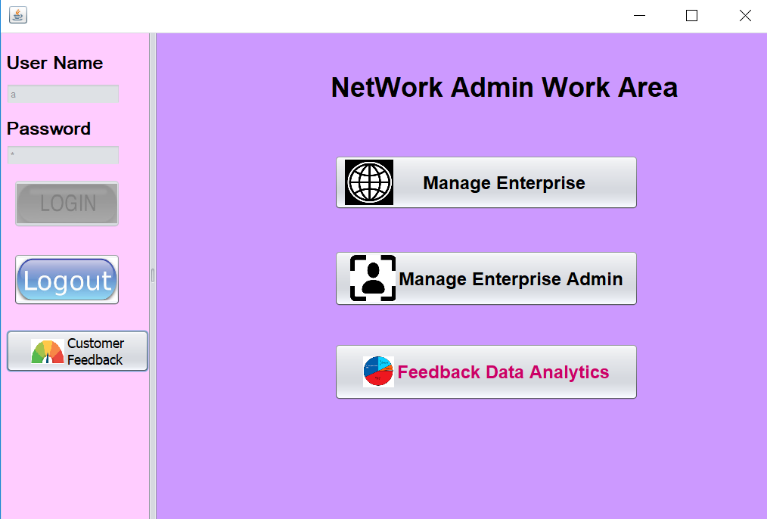
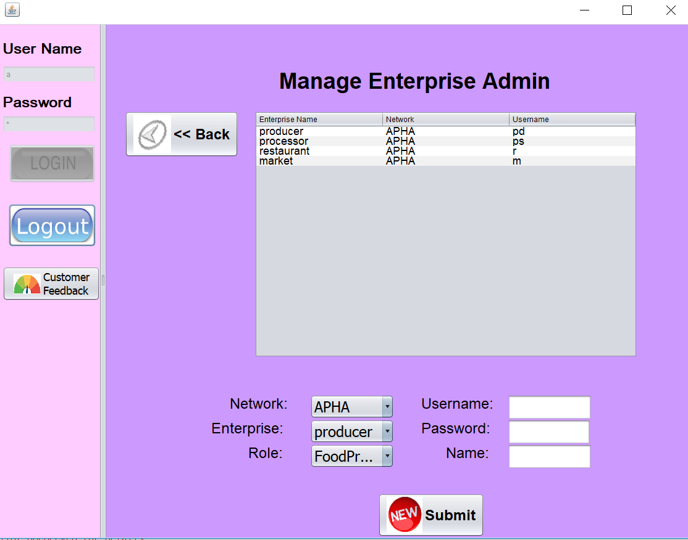
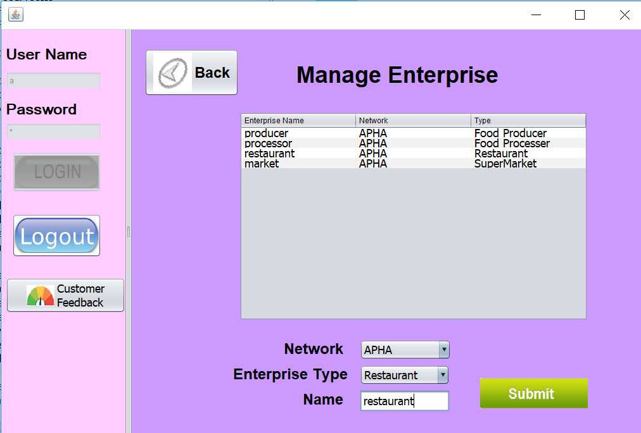

Slide 25
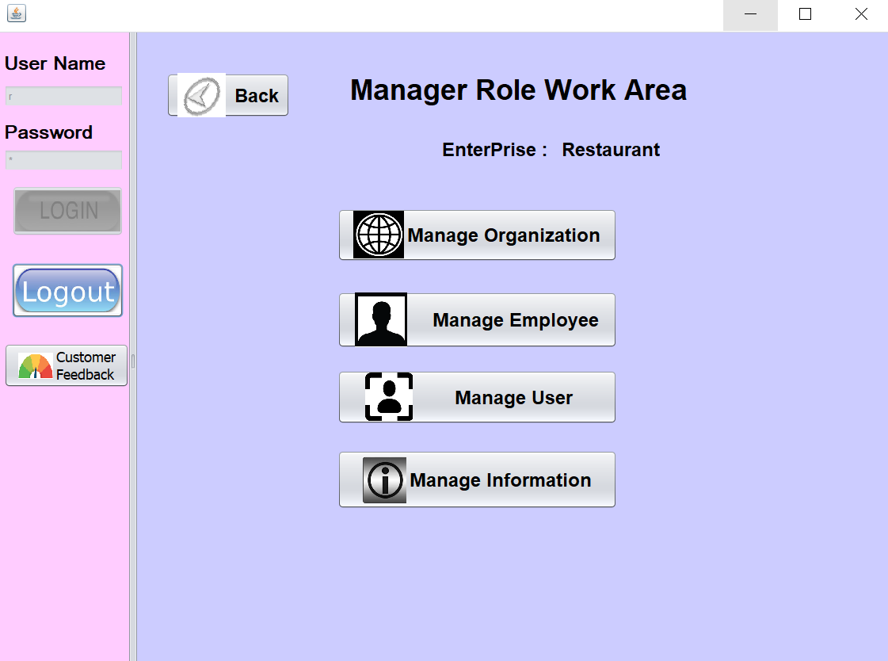
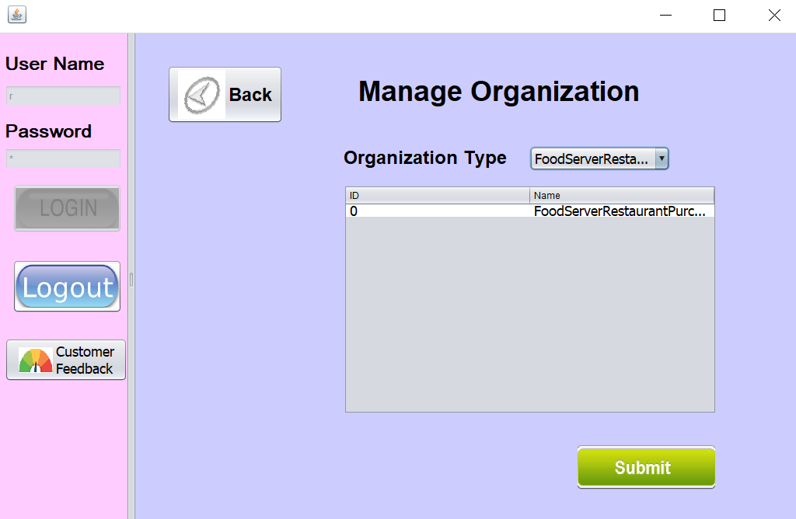
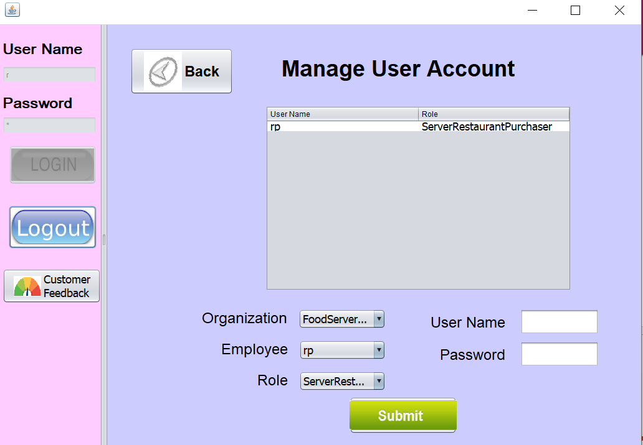

Slide 26
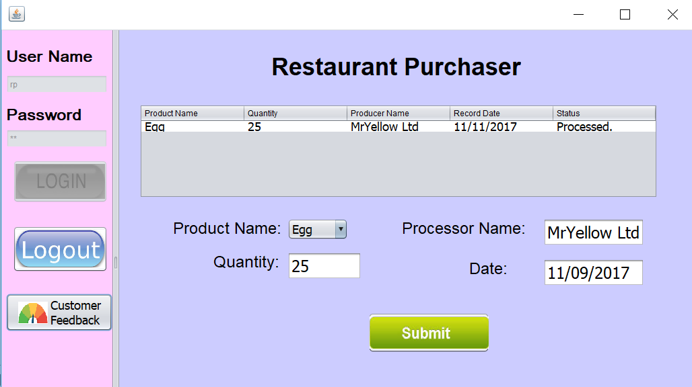

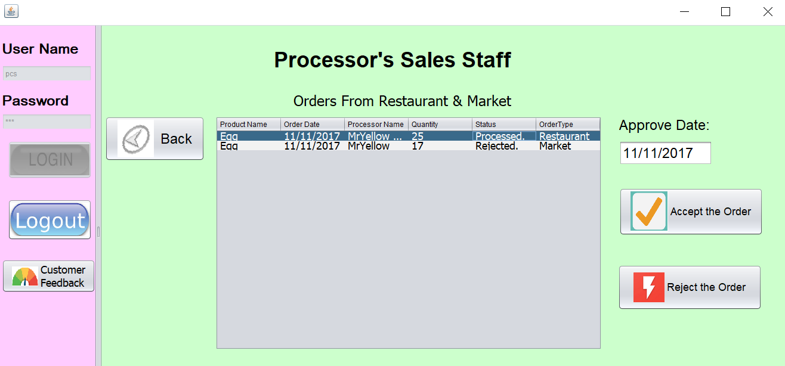

Account Manager (Processor):
Connection between Processor & Server:
Escalate Revenue Issues:

Slide 27
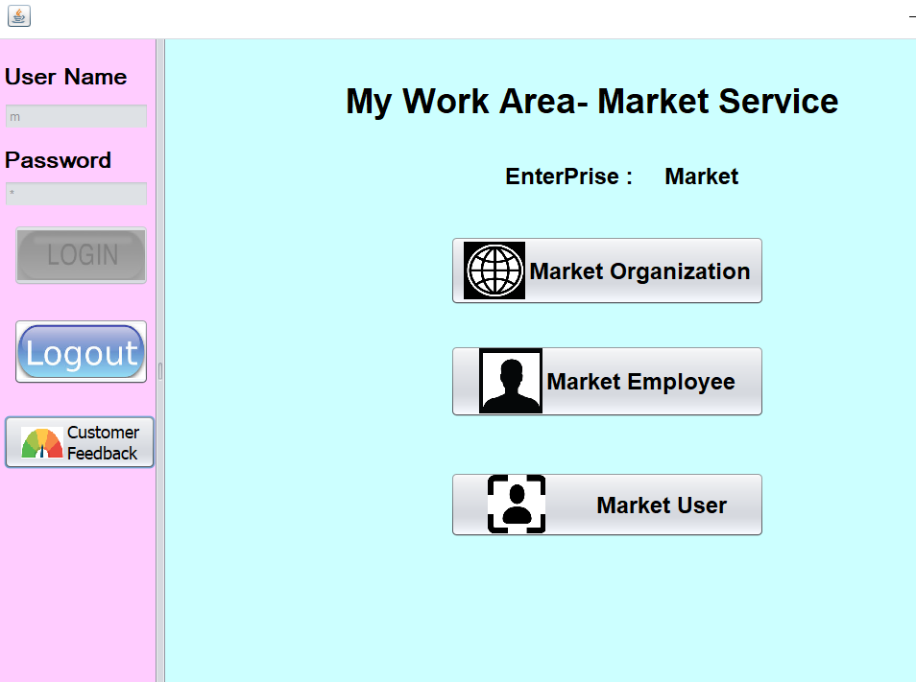
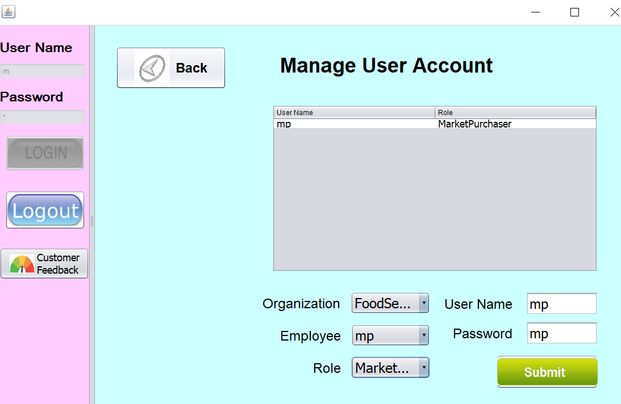
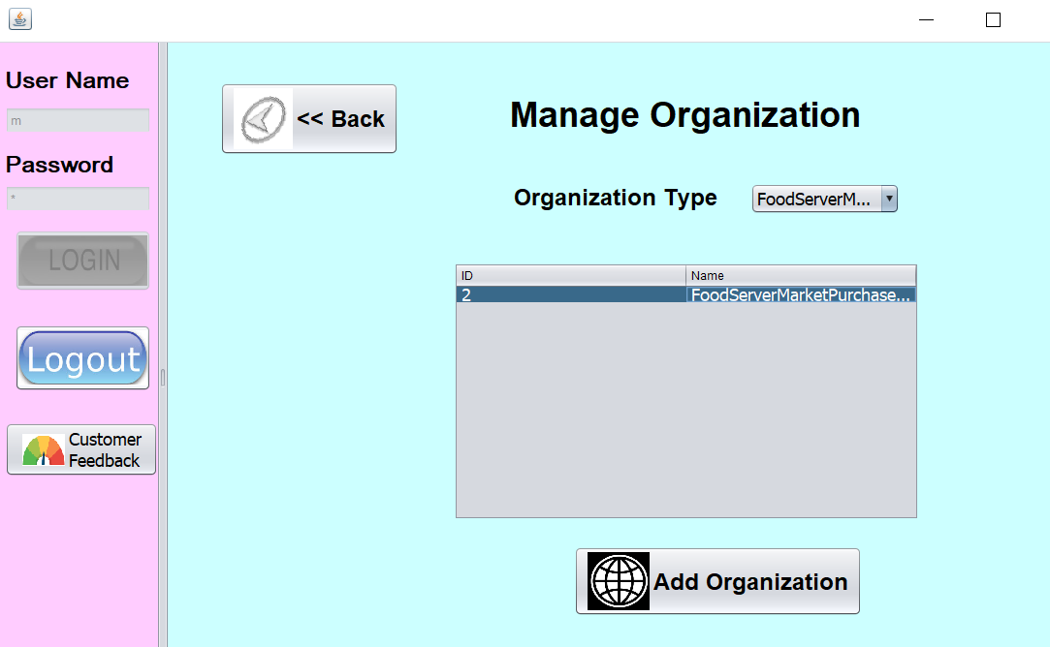
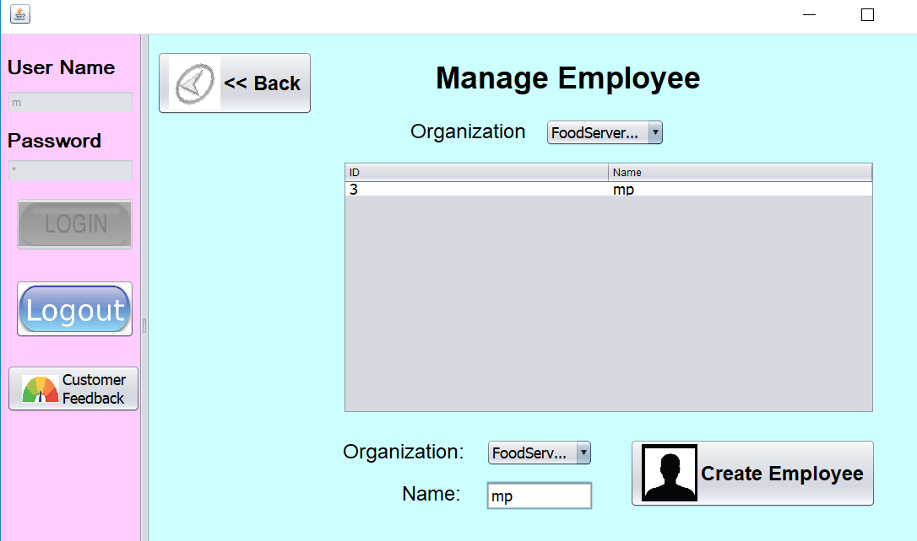

Slide 28
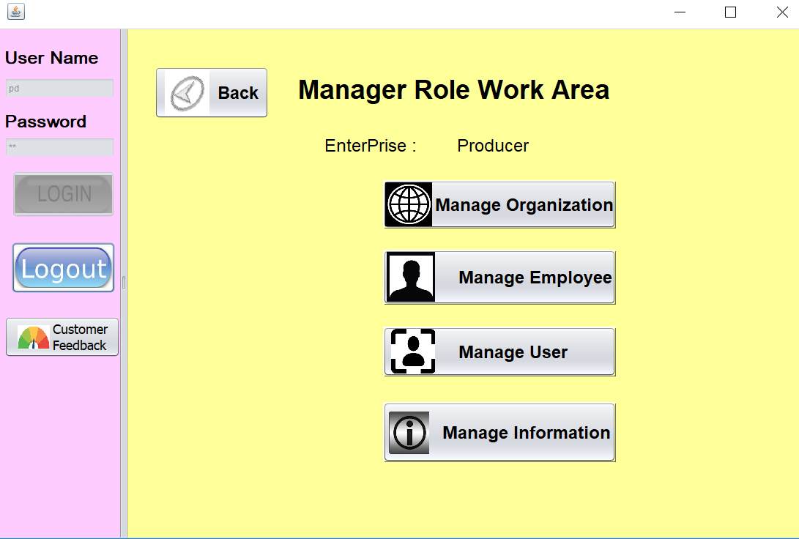

Slide 29
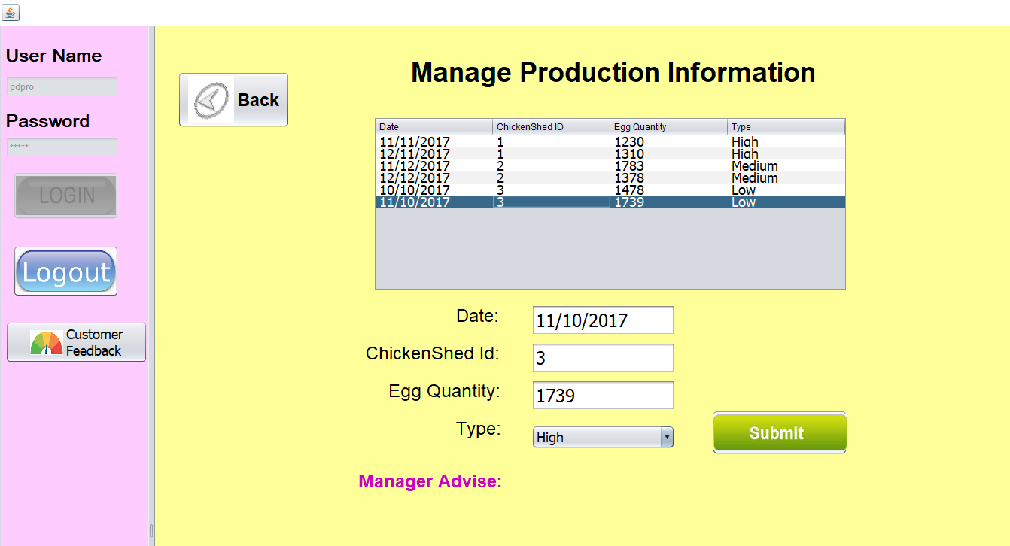
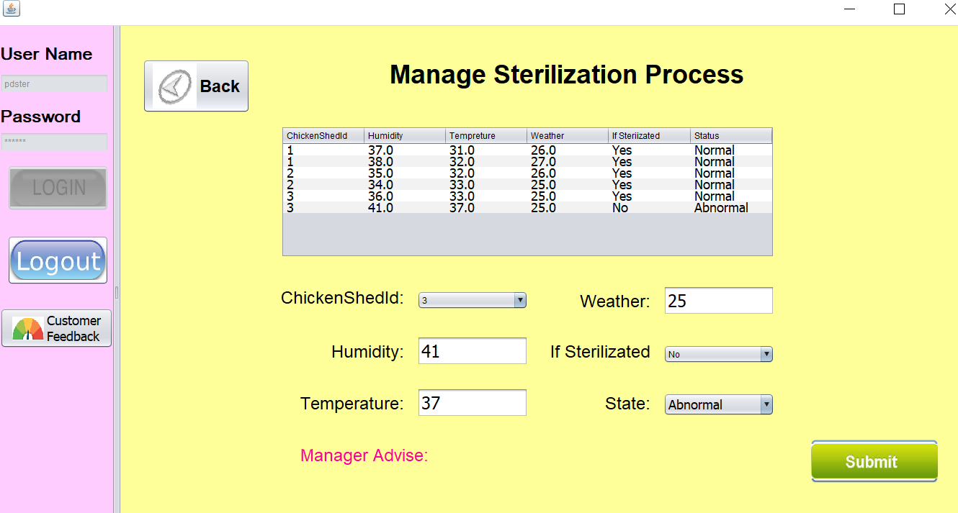
Producer—Manage Production:
Sterilization & conditions in Chicken sheds!!!

Slide 30
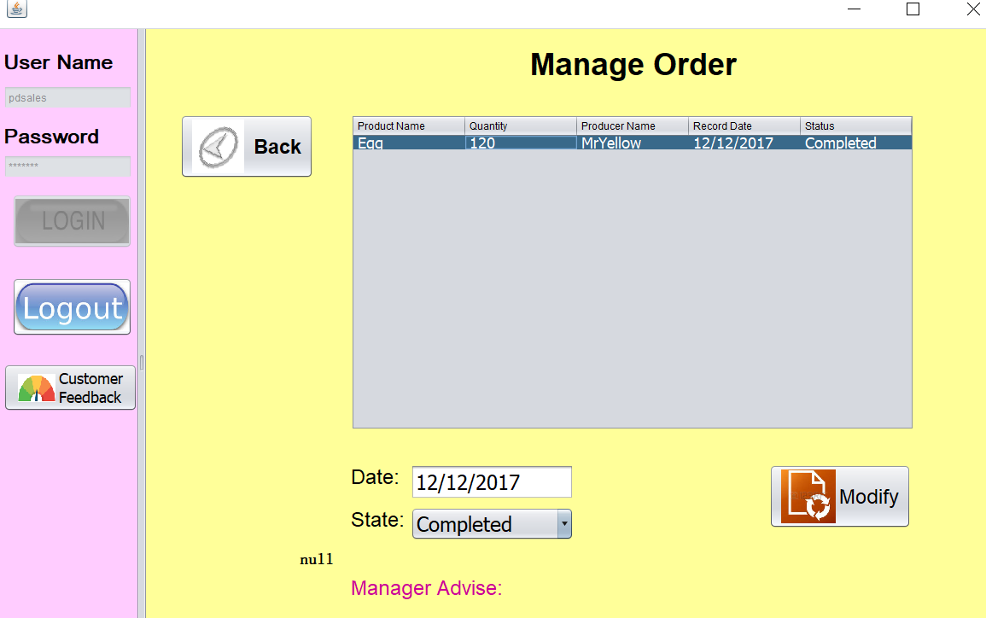
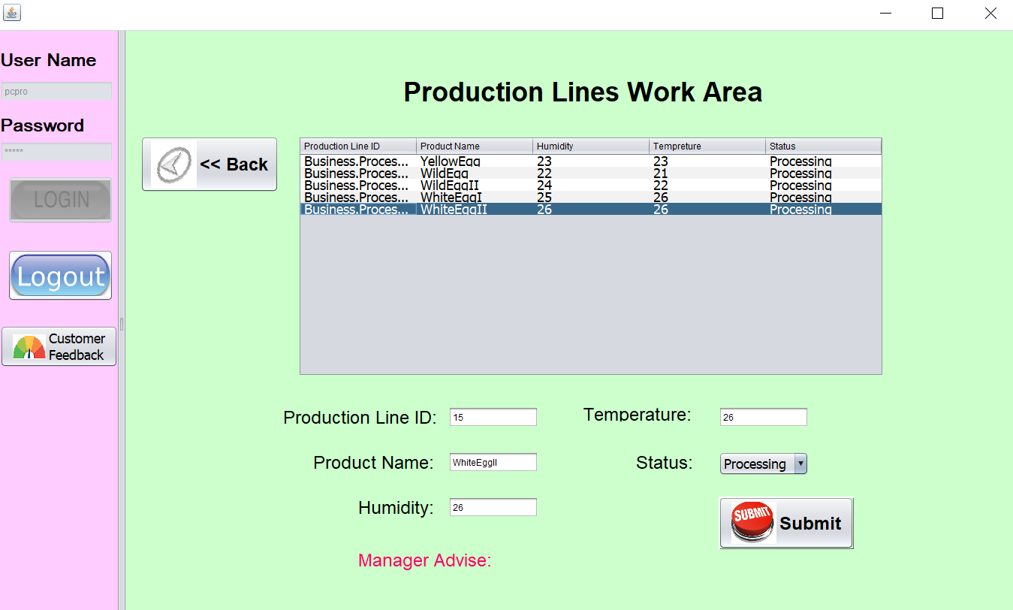
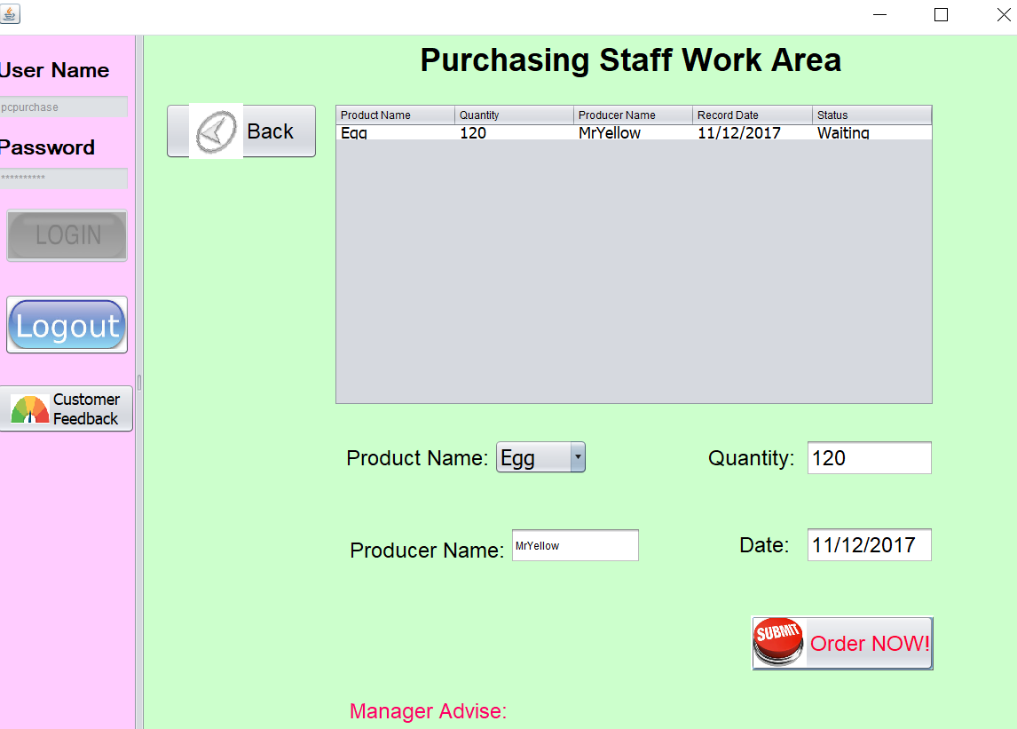
Processor Manage Production Lines:
Producer Manage the orders:
Processor Purchaser: make order to producer

Slide 31
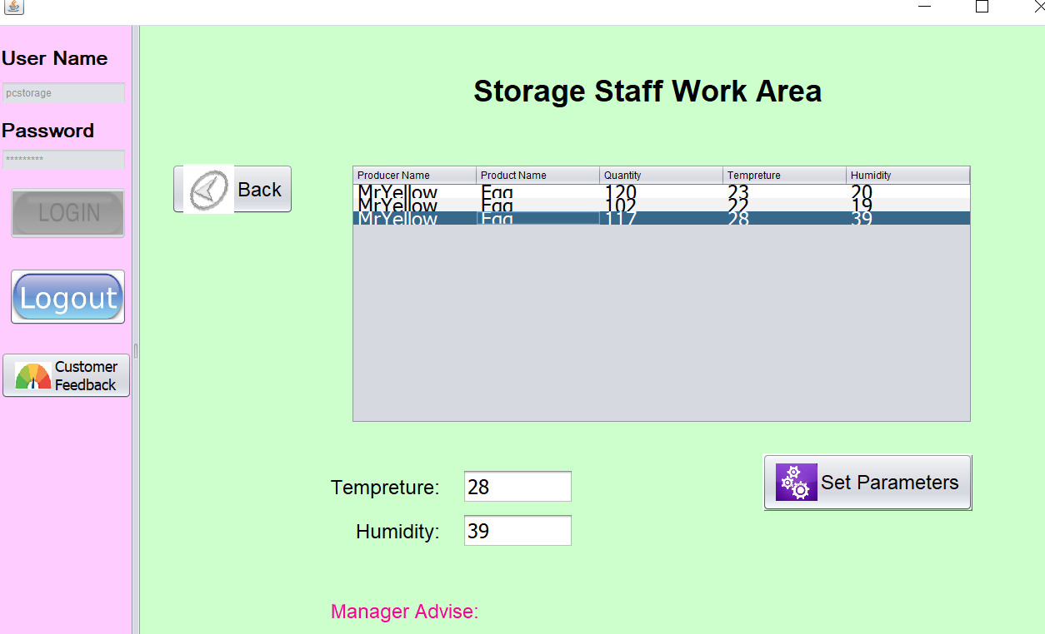
Processor Storage Staff: Manage the conditions of inventory…

Slide 32
Appendix: Our Schedule Record
1. For weekend PPT view:
Ziwei-Focus on the PPT writing.
Xin & Rahil: Select your part to prepare for viewing this weekend.
2. For Week of 11.20:
(1)Nail down the features, Roles, Schedule: By 11.20:
Think about the features by different part:
Such as, Rahil--Food(Raw material) Planting; Xin--Food process; Ziwei--Alert & Prediction.
(2)Start from 11.21

Slide 33
Appendix: Material List
Meeting Minutes
Work Sheets
Proposal

